Slide 1
Book1
File created on: 08-06-2023 21:47:38

Slide 2
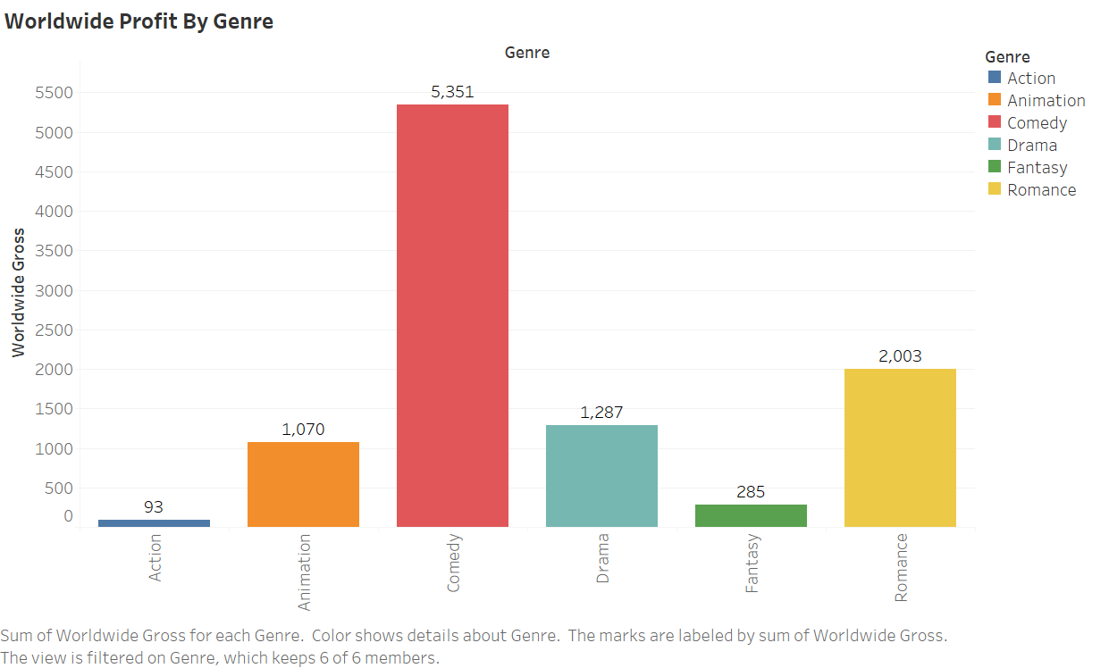

Slide 3
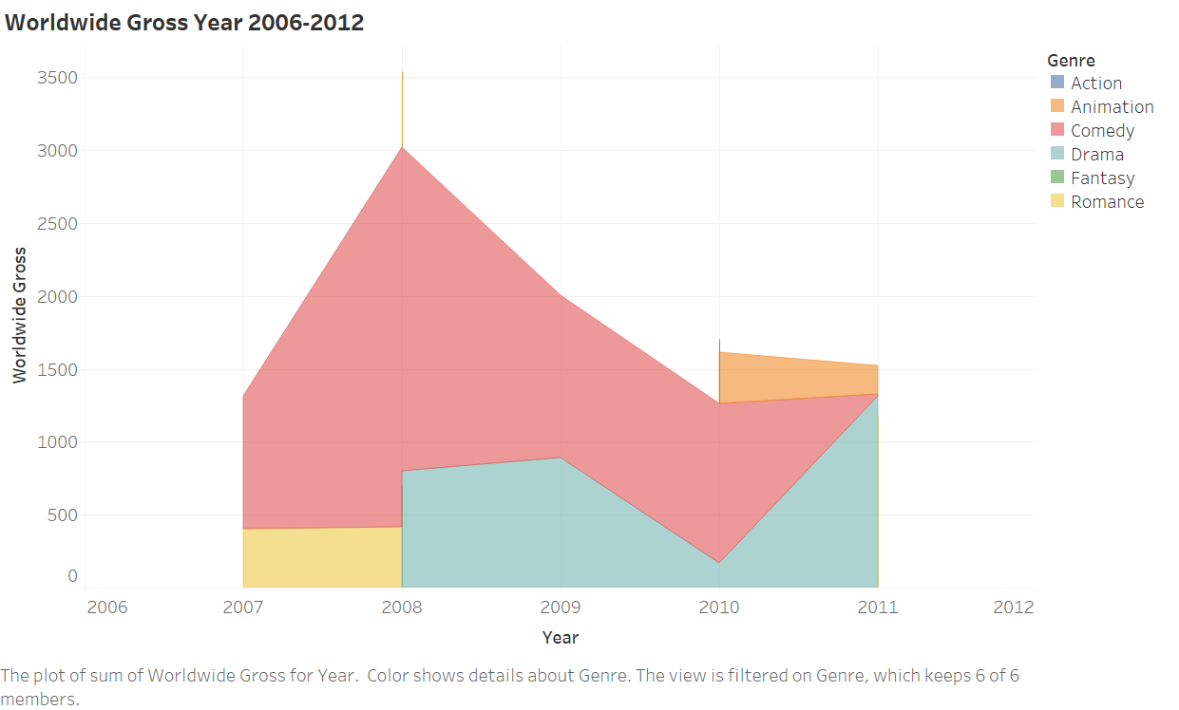

Slide 4
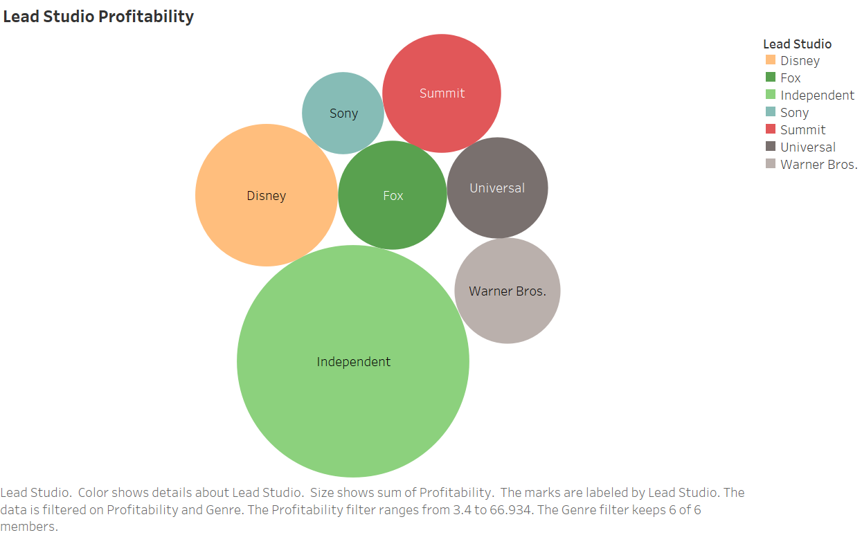

Slide 5
